Slide 1
Subarachnoid haemorrhage
Chamila Mettananda
Senior lecturer and Consultant Physician
02.02.2016

Slide 2
Introduction
What is it?
Presentation
Causes
Investigation
Complications
Management

Slide 3
Subarachnoid haemorrhage
leakage of blood into subarachnoid space
spontaneous
traumatic

Slide 4
Presentation

Slide 5
Presentation
acute onset
headache - abrupt, explosive - ‘thunderclap’ ‘worst headache ever’ occipital, with neck pain, vomiting
  SAH until proven otherwise
altered consciousness → coma
meningeal irritation
‘warning bleeds’

Slide 6
Presentation … - other
focal symptoms/ signs
  with involvement of adjacent structures
cranial nerve palsies -
  III - with post. communicating A. aneurysm
photophobia
retinal haemorrhages - ‘subhyaloid’

Slide 7
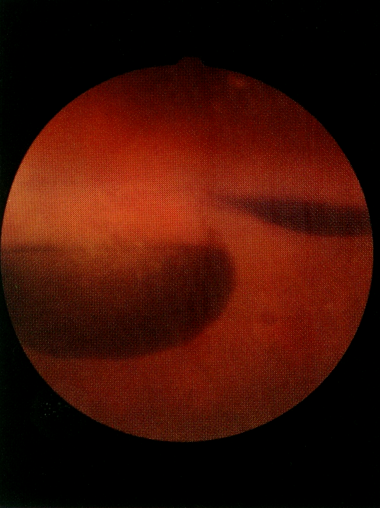

Slide 8
Causes
aneurysm 60-70%
peri-mesencephalic venous haemorrhage 15-20%
AVM 5-10%
other - vasculitis
bleeding tendency
tumour associated
drug abuse
spinal SAH

Slide 9
‘Berry’ aneurysms
  usu. at arterial bifurcations
  ant. communicating A.
  post. communicating A.
  middle cerebral a.
  ICA/ MCA origin
can be associated with
  polycystic kidney disease, coarctation of aorta

Slide 10
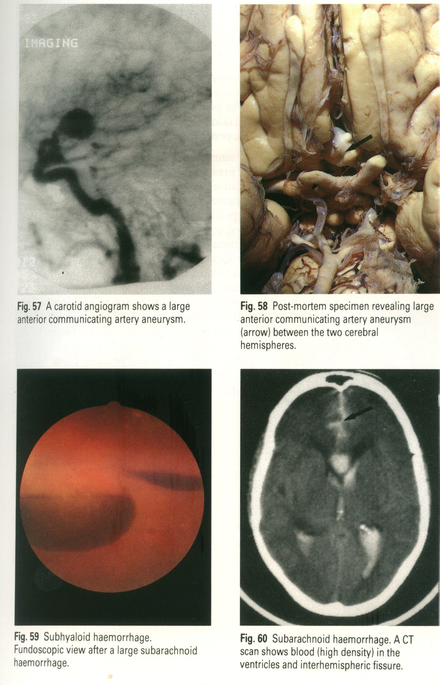

Slide 11
Investigation of SAH

Slide 12
Investigation - 1- confirm SAH
CT scan - non-contrast
CSF
  uniformly blood stained CSF
  xanthochromia after a while - on spectrophotometry

Slide 14
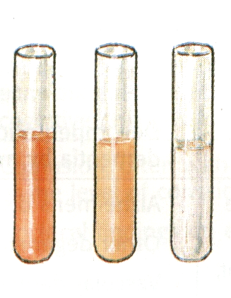
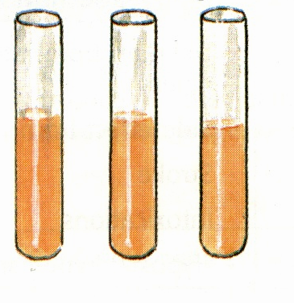
SAH traumatic tap

Slide 15

SAH SAH - late tap - xanthochromia

Slide 16
Investigation - 1- confirm SAH
CT scan - non-contrast
  +ve - <24h - 90-95%
  3d -80%, 5d -70%, 7d -50%, 2 weeks -30%
CSF
  uniformly blood stained CSF
  xanthochromia - on spectrophotometry
  only after 2h (time for red cell lysis)
  >12h - 90%, 3 weeks - 70%, 4 weeks - 40%

Slide 17
Investigation - 2- detect source of bleeding
angiography
  convetional contrast angio/ DSA
  CT angio
  MR angio

Slide 19
Complications

Slide 20
Complications
Local
raised ICP
re-bleed
acute hydrocephalus
‘vasospasm’ - delayed ischaemia - infarcts
seizures
Systemic
hyponatraemia
hypovolaemia
hypotension
fever
hyperglycaemia
neurogenic pulmonary oedema
cardiac - arrhythmias, ECG changes

Slide 21
Management - General care
Medical emergency
ABC
bed rest
check on - fluids, sodium, glucose, feeding, …
pain relief, anti-emetic
avoid straining

Slide 22
Management - specific treatment
nimodipine
  prevent delayed cerebral ischaemia
neurosurgical evaluation in ALL cases
surgery - early, less severe cases
  aneurysm clipping
  endovascular treatment - coiling

Slide 23
Subarachnoid haemorrhage
medical emergency
thunderclap headache, neck stiffness
CT 1st, then LP
neurosurgical evaluation

